Slide 1

A Dive Into Airway Review Data: Sentiment Analysis
A Data-Drive journey through customer review

Slide 2
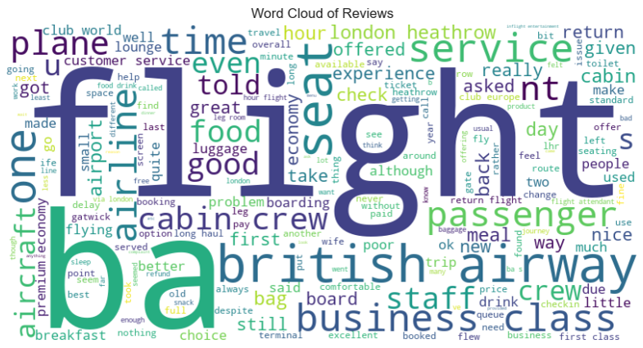
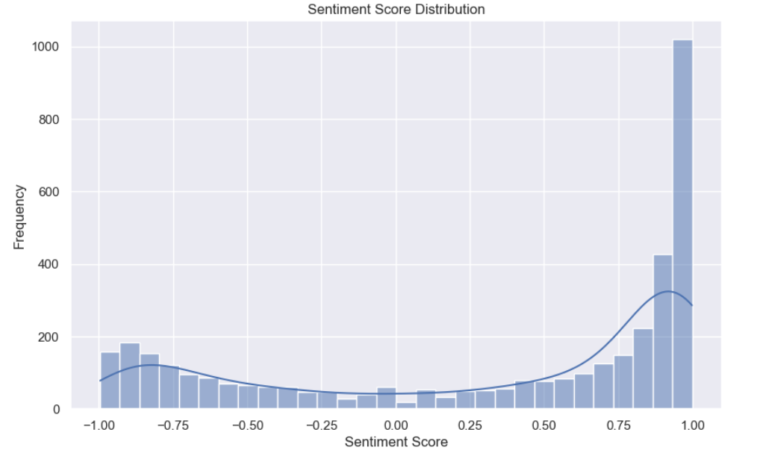
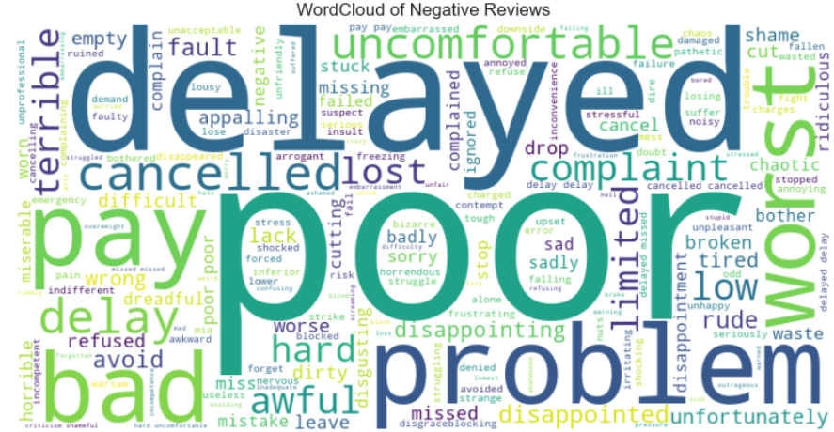
Positive sentiment dominance
There is significant spike at sentiment score of 1.0,indicating larger number of reviews have highly positive sentiments.
Negative Sentiment Presence:
There is a noticeable number of reviews with negative sentiment scores, particularly around -0.75 to -1.0
Neutral Sentiment:
Reviews with neutral sentiment (scores around 0) are less frequent compared to both highly positive and highly negative sentiments.
Overall Distribution:
The distribution is skewed towards the positive side, indicating that dataset contains more positive reviews than negative or neutral ones.
Inferences:
The dominance of positive reviews can be a positive indicator for businesses looking to gauge customer satisfaction.
The presence of negative reviews, although less frequent, should be addressed to improve overall customer experience.

